Slide 1
Voluntary CORE Certification Basics: The Gold Standard
July 13, 2017
2:00 – 3:00 pm ET

Slide 2
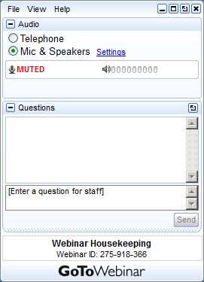
Logistics Presentation Slides & How to Participate in Today’s Session
Download the presentation slides at www.caqh.org/core/events.
Click on the listing for today’s event, then scroll to the bottom to find the Resources section for a PDF version of the presentation slides.
Also, a copy of the slides and the webinar recording will be emailed to all attendees and registrants in the next 1-2 business days.
Questions can be submitted at any time with the Questions panel on the GoToWebinar dashboard.

Slide 3
Thank You Speakers!
CAQH CORE would like to thank our guest presenter for today’s webinar.
Ashish Gandhi
Senior Technical Project Manger
Sergiu Rata
Senior Director of Product Management
Cristina Puscas
Senior Product Analyst, Smart Trading
3

Slide 4
Session Outline
Voluntary CORE Certification – Why are so many in the industry becoming CORE-certified?
CORE Certification Process & Resources.
Edifecs Testing Portal.
Dialog on Certification Challenges & Resources.
Q&A.

Slide 5
Voluntary CORE Certification – Why are so many in the industry becoming CORE-certified?
Taha Anjarwalla
CAQH CORE Manager

Slide 6
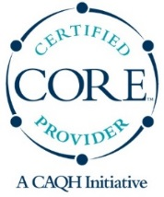
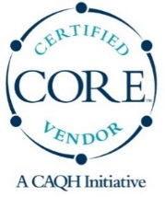
Voluntary CORE Certification Developed BY Industry, FOR Industry
CORE Certification is the most robust and widely-recognized industry program of its kind – the Gold Standard. Its approach assures an independent, industry-developed confirmation of conformance with operating rules and underlying standards.
Requirements are developed by broad, multi-stakeholder industry representation via transparent discussion and polling processes.
Required conformance testing is conducted by third party testing vendors that are experts in EDI and testing.
CAQH CORE serves as a neutral, non-commercial administrator.
Authorizes the conformance testing vendors.
Reviews and approves the Certification applications, e.g. trading partner dependencies, number of platforms, and conformance test reports before a Certification Seal is awarded.

Slide 7
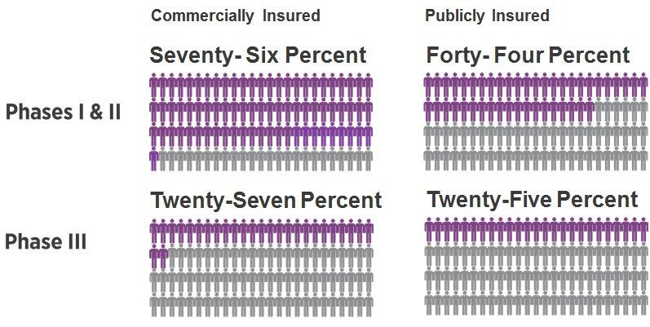
CORE Certifications Phase I-IV Entities Recognizing the Benefits Continues to Grow
320
Certifications have been awarded
since the program’s inception.
Covered lives impacted by CORE-certified commercial and public health plans.
Recent Certifications
Boston Medical Center HealthNet Plan (Phase I, II & III)
CalOptima (Phases I, II, & IIII)
National Association of Letter Carriers Health Plan (Phases I & II)
Government Employees Health Association (Phases I & II)
Notes:
We

Slide 8
How Much Could the Industry Save?
2016 CAQH Index Reported Labor-only Savings Opportunity for Six HIPAA Transactions that have CAQH CORE Operating Rules; Adoption by Transaction is at Different Stages:
Eligibility and Benefit Verification (Phases I-II).
Claim Status Inquiry (Phase II).
Claim Payment (Phase III).
Remittance Advice (Phase III).
Claim Submission (Phase IV).
Referral Certification (Phase IV).
Report used data from 5.4 billion transactions.
These cost estimates only represent a fraction of the true industry savings opportunity associated with adoption of electronic transactions:
Includes direct labor cost for only six of the twelve key transactions in the claims cycle for commercial plans.
A more comprehensive estimate of industry cost savings opportunity would include indirect and direct cost for all twelve transactions in the claim cycle for private and public payers.
$9.4 Billion
Other Cost Not Currently in CAQH Estimates
Six Additional HIPAA Transactions
Indirect Labor Cost (transaction prep & follow-up)
Vendor and Other Overhead
Public Payers
Host of Other Transactions Beyond HIPAA
Total Industry Savings Opportunity =
? Billions
8

Slide 9
Voluntary CORE Certification ROI
Electronic insurance eligibility verifications took approximately seven minutes less than telephone verifications, saving providers $3.59 per verification. There are more than 1.5 billion claims verified for eligibility each year in the U.S.
Providers working with CORE-certified health plans saw 10-12% fewer claims denials, resulting in improved practice payment.
Electronic remittance advice adoption (55%) continues to steadily increase, but more than a third are still being sent via mail. Providers could save 12 minutes and $4.74 per transaction by switching to ERA.
Providers who switched to electronic prior authorizations saved 14 minutes and $5.61 per transaction.
Sources: CAQH Index 2016, IBM 2009

Slide 10
CORE Certification Testimonials
“For Aetna, becoming CORE Certified has been a priority. Completing certification Phases I, II and III helps us both push the industry forward and ensure that all of our business partners – especially healthcare providers – receive the benefits of the rules.”
-Lou Ursini, CAQH CORE Board Chair, Head, IT Program Delivery & Testing, Aetna
“As a provider-owned health plan, we have a unique understanding of how critical it is for data to flow seamlessly and securely between payers, hospitals and other partners. The CORE seal demonstrates to all of our partners our commitment to efficient data exchange and it enables us to identify partners that we can count on to do business efficiently, so we can focus on coordinating the care of our members.”
-Kim Sinclair, Chief Information Officer, Boston Medical Center Health Plan (part of the Boston Medical Center Health System)
“Operating rules and standards work best when everyone involved in a transaction adheres to them. By becoming CORE-certified, we are helping our clients meet – and exceed – an important regulatory mandate, while contributing to a more efficient healthcare system for everyone.”
-Cate McConnell, Director of Product Management, Payer Services, McKesson/Relay Health
Health Plan
Provider
Clearinghouse/
Vendor

Slide 11
Phase Certification & Tangible Benefit
Phase | Benefit
Phase I | Faster patient registration and improves revenue cycle management as providers are able to verify health plan coverage and will know the proper co-pay and deductible while the patient is present, not after the fact requiring follow-up. Real-time eligibility and benefit checks reduces claim denials, preventing patients from receiving unexpected bills and helping providers avoid taking on bad debt.
Phase II | Decreases duplicate claim submissions as claim status information is provided in real time, taking no longer than 20 seconds round- trip. Reduces misidentification of patients and mistaken denials by improving how patient names are stored and retrieved during eligibility checks.
Phase III | Improves cash flow via expedited payment and remittance reconciliation through the receipt of electronic payments and remittances. Eliminates the need for manual re-keying of reconciliations of EFTs and ERAs by requiring a trace number that links the two transactions so payments can be associated with service. Increases ability to conduct targeted payment issue follow-ups through uniform and maintained ERA codes (CARCs, RARCs, and CAGCs) to give the market consistency in reporting and interpreting the claim denials/adjustments.
Phase IV | Enhances revenue cycle management during healthcare claim submission as use of operating rules means providers will immediately learn if the claim submission was successfully received by the plan and moved into their adjudication system; providers are quickly made aware of obvious errors, so they can be corrected, reducing payment time. Reduces staff time on manual phone or fax inquiries for prior authorization requests as operating rules help inform whether a health plan has received and is reviewing a prior authorization request for a specific medical procedure or service. Alleviates delays or errors in processing employee change-of-life events through acknowledging the receipt of employee information between health plan and employer.
CLAIM

Slide 12
Benefit: Gold Standard
Industry-Driven Benefits
Positions organizations as leaders in administrative efficiencies.
Establishes conformance with federally mandated operating rules and underlying standards.
Demonstrates ability to conduct secure, timely and streamlined electronic transactions.
Ensures real-time access to eligibility information for beneficiaries.
Lowers cost within claim processing systems.
With measures taken to achieve CORE Certification through operating rule conformance, entities can prepare for potential external audits/penalties.
Multi-stakeholder Collaboration
CAQH CORE is governed by a multi-stakeholder, executive-level board to address the interests of more than 130 participating organizations.
The CORE Certification program was developed by CORE Participants representing health plans, providers, clearinghouses, vendors, government agencies and associations across the healthcare industry.
Any organization that can create, transmit, or use healthcare administrative transactions can complete CORE Certification.
Health Plans
Clearinghouses
Government Agencies
Vendor
Solutions
Associations/Other
Providers

Slide 13
Benefit: Comprehensive Approach
Benefits of Pledging and Pursuing Each Phase of Certification
By signing the CORE Certification Pledge, your organization has the potential to become a part of the collaborating effort for utilizing operating rules, standing out among other organizations.
Through the CORE Certification program your organization can increase the usefulness of, and reduce the administrative challenges, associated with the infrastructure requirements/data content of electronic transactions.
CORE Certification involves a phased approach, building off of a previous phase, providing an end-to-end testing suite that is both robust and comprehensive.
For each phase, infrastructure requirements apply across transactions and include: Connectivity & Security, Response Time, System Availability, Exception Processing/Error Resolution, Roles & Responsibilities, Companion Guides, and Acknowledgements.
Phase IV
Phase III
Phase II
Phase I

Slide 14
Benefit: Conformance
Compliance with Administrative Simplification requirements yields benefits to the healthcare industry.
Healthcare providers, health plans, payers, and other HIPAA-covered entities must comply with Administrative Simplification.
CMS, on behalf of HHS, has the authority to investigate complaints and audit for compliance with HIPAA standards, including authority with respect to the Administrative Simplification provisions of the:
Health Insurance Portability and Accountability Act of 1996 (HIPAA)
Patient Protection and Affordable Care Act of 2010 (ACA)
CORE Certification means an entity has demonstrated its IT system or product is operating in conformance with applicable requirements of a specific phase(s) of the CAQH CORE Operating Rules.

Slide 15
Benefit: Leadership
Establish your role as an industry leader as an adopter of the operating rules and underlying standards.
Publicly demonstrate commitment to administration simplification.
Build on implementation efforts and showcase that your organization adheres to federally mandated operating rules and standards.
Engage your trading partners and understand your contracting agreements to ensure optimal electronic data flows.
There is a substantial portion of the market that is already experiencing the efficiencies from the CAQH CORE Operating Rules – 76% of commercially insured and 44% of publicly insured are currently Phase I & II certified. Don’t get left behind!

Slide 16
Benefit: Resources/Customer Service
Free Tools & Resources
There are numerous resources that can be accessed for free to ensure your CORE Certification success.
Website: www.CAQH.org/CORE
CORE Customer Service Promise
CORE staff are happy to set up a consultation to answer your questions and walk you through the CORE Certification process.
Email: CORE@CAQH.org

Slide 17
CAQH CORE Enforcement Policy Ensuring Ongoing Compliance
CORE-certified entities adhere to not only the operating rules, but CORE Certification Polices, CORE Certification Testing requirements, and HIPAA Attestation Form requirements in order to become certified. As such, the CAQH CORE Enforcement Policy allows CAQH CORE to enforce ongoing compliance of operating rules and underlying standards for CORE-certified entities.
Who Benefits from CAQH CORE Enforcement?
CAQH CORE Enforcement Policy
Empowers industry to ensure they are receiving and maximizing benefits afforded via CORE-certified entities; critical to providers and plans.
Helps industry prepare for potential external audits/penalties.
“By industry, for industry” approach demonstrates self-policing and self-reporting capabilities.
No changes for CORE-certified entities.
Multi-stakeholder approach allows end-to-end monitoring of conformance across trading partners.
Applies to every type of entity that is CORE-certified, not just health plans.
CORE Participant-approved policy to address non-compliance by CORE-certified entities.
Any healthcare provider that is an end-user of a CORE-certified product/service/health plan or any CORE-certified entity may file a complaint against an alleged non-compliant CORE-certified entity.
Complaint-driven and collaborative process that fosters industry collaboration through remediation, not penalties.
If a CORE-certified entity is found to be in violation and the violation is not remedied per required timeline, the entity’s certification is terminated.
File a complaint: Is your CORE-certified trading partner non-compliant? Click HERE to start the complaint process by filling out the Non-Compliance Complaint Form to document instances of non-compliance.
Learn more: Have any questions or would like to learn more about the CAQH CORE Enforcement policy, contact core@caqh.org.
17

Slide 18
Highlights of CORE Certification Pledge → Testing and Review → Voluntary Enforcement
CORE Certification – the only program of its kind – was developed by industry, for industry with broad, multi-stakeholder representation. Ensures that organizations receive and maximize the benefits from the operating rules and underlying standards from CORE-certified trading partners on a continual basis. Commitment to CORE Certification formally kicks off with an executive signing the CORE Certification Pledge, which allows CORE to publicly share an entity’s commitment to implementation in 180 days. | Required CORE Certification testing is conducted by expert third party testing vendors, assuring an independent assessment of conformance with the operating rules and their underlying standards. CAQH CORE serves as a neutral, non-commercial administrator that reviews and approves the conformance test reports, and conducts additional, thorough examinations before awarding a Certification Seal. | The CAQH CORE Enforcement Policy is a key element of CORE Certification. It reinforces that the CORE Seal represents value, trust and achievement in what can be a complex data exchange with multiple parties. It helps certified entities proactively work to avoid potentially costly external enforcement audits and penalties through supporting industry self-policing.
PLEDGE
TEST

Slide 19
Polling Question #1
For what reason would your organization become CORE-certified? (Select all that apply.)
Demonstrates conformance with the operating rules.
Improves business processes leading to greater efficiencies for our customers (for example, requires real-time patient financials for providers).
Provides an objective assessment of our systems through the use of a third-party tester (CORE-authorized) and industry-supported certification organization (CAQH CORE).
All of the above.
Other: Please specify in Questions panel.

Slide 20
CORE Certification Process & Resources
Taha Anjarwalla
CAQH CORE Manager

Slide 21
Types of CORE Seals
CAQH certifies and awards CORE Certification Seals to entities that create, transmit, or use the healthcare administrative and financial transactions addressed by the CAQH CORE Operating Rules.
CORE Certification Seals are categorized into four CORE Certification stakeholder types: Providers, Health Plans, Clearinghouses, and Vendors.
In addition to stakeholder type, CORE Certification is specific to how an entity conducts a transaction as an information source, information requester or both.
Health Plans and Providers: To become certified on a higher phase of CAQH CORE Operating Rules, these stakeholders must be CORE-certified on the earlier phases. Further, these stakeholders can leverage certifications from their vendors and clearinghouses to become CORE-certified themselves.
Vendors and Clearinghouses: Given that vendors/clearinghouses offer products and services that may only address certain transactions, these stakeholders may become CORE-certified on only the relevant CAQH CORE Operating Rules phases.
CORE Certification on specific phases of the CAQH CORE Operating Rules can be completed concurrently or successively.

Slide 22
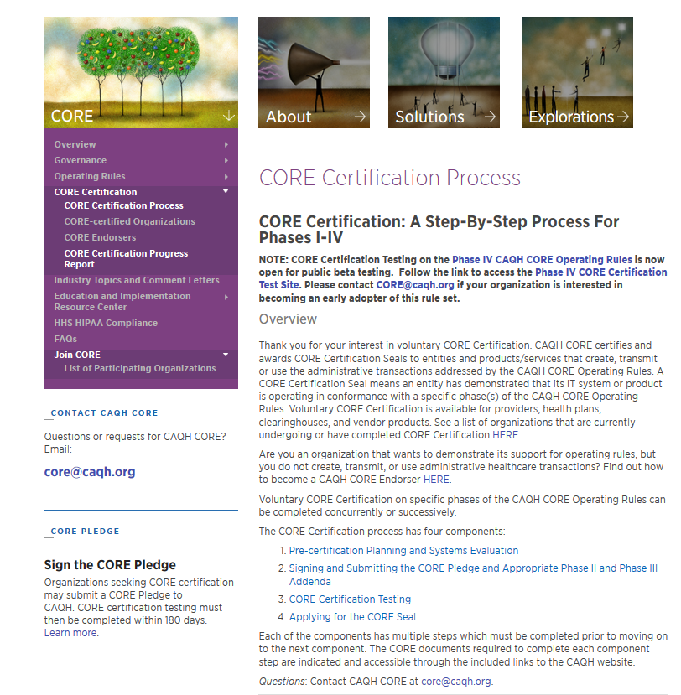
CORE Certification’s Four Component Process
http://www.caqh.org/core/core-certification-process
Component 1
Pre-certification Planning & Systems Evaluation
Component 2
Sign and Submit CORE Pledge
Component 3
CORE Certification Testing
Component 4
Apply for CORE Certification Seal
22

Slide 23
1: Pre-certification Planning and Systems Evaluation
Component 1
Pre-certification Planning & Systems Evaluation
Understand requirements of the CAQH CORE Operating Rules and scope your internal efforts to adopt and implement the operating rules
23

Slide 24
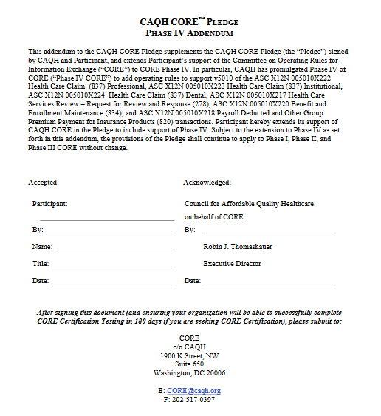
2: Sign and Submit the CORE Pledge
Component 2
Sign and Submit CORE Pledge
Formally communicate your intent to pursue CORE Certification for a given phase of CAQH CORE Operating Rules
24

Slide 25
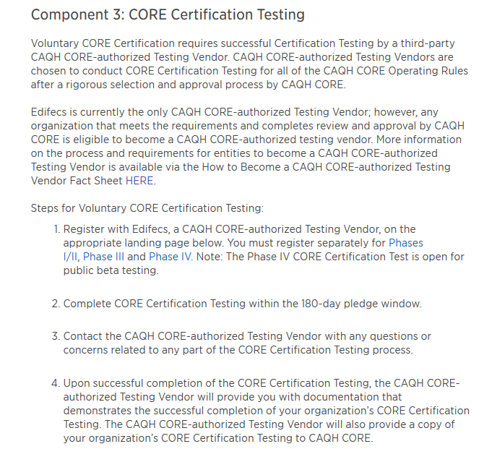
3: CORE Certification Testing
Component 3
CORE Certification Testing
An entity seeking CORE Certification works with a CORE-authorized testing vendor to perform tests based upon CORE Phase I-IV testing criteria specific to that entity’s stakeholder type.
25

Slide 26
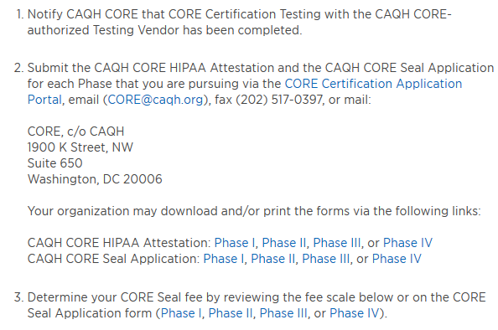
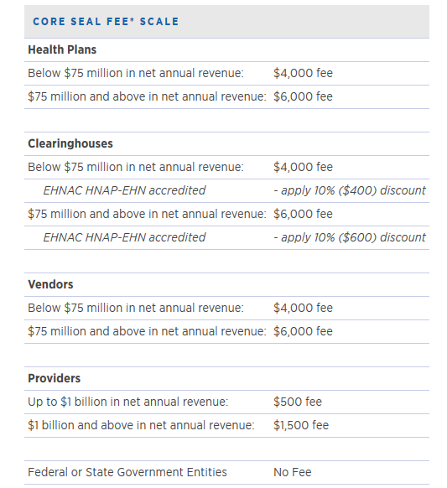
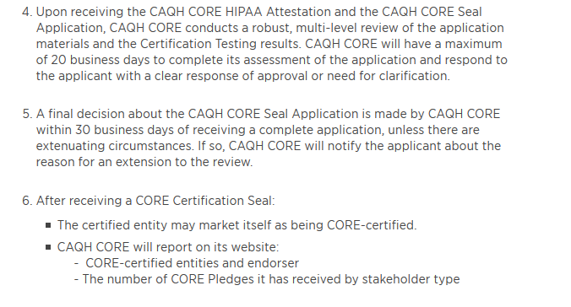
4: Applying for the CORE Seal
Component 4
Apply for CORE Certification Seal
Complete and submit a CORE Seal Application Form, CORE HIPAA Attestation Form, and CORE Seal Fee.
26

Slide 27
Voluntary CORE Certification: Resources
CAQH CORE Analysis and Planning Guides: Identifies system/software gaps and helps create a project plan to complete any necessary system remediation.
CAQH CORE Certification Test Suites & CAQH CORE Master Test Bed Data: Identifies stakeholder-specific conformance testing requirements of the CAQH CORE Operating Rules for voluntary CAQH CORE Certification.
CAQH CORE staff support via phone (202.517.0375) and email (CORE@CAQH.org).
Free resources from Edifecs, CORE-authorized Testing Vendor (Info.CoreCertification@edifecs.com).
CAQH CORE FAQs: Addresses questions pertaining to technical rule requirements and stakeholder specific implementation on the CAQH CORE Operating Rules.
e-Learning Tools: Provides interactive dashboards and modules to learn about Voluntary CORE Certification.
27

Slide 28
Polling Question #2
What stage of certification is your organization currently in? (Select all that apply.)
Information gathering.
Organizational buy-in.
System remediation.
Resource allocation and project planning.
Pursuing CORE Certification (signed CORE Certification Pledge)/Already CORE-certified.

Slide 29
Polling Question #3
What resources/tools were or would be most beneficial to your certification planning? (Select all that apply.)
Analysis & Planning Guide.
Consultation.
E-Learning Modules.
Decision-making Templates.
Other: Please specify in Questions panel.

Slide 30
Value of Certification beyond Conformance Testing
Sergiu Rata
Senior Director, Product Marketing

Slide 31
Top 5 Value Points
Natural Progression | Partner Communication | Competitive Advantage | Claim Response Standardization | Cost Influencer
CORE Phase IV is an easy continuation of II and III framework with one standard protocol for transmission with a uniform claims submission process. | Provide a superior service, more transparency, and smoother go-live onboarding to the partner community (with defined test cases and detailed responses). | Positive impact on membership, ease of provider network management, and assist with rate negotiations. More predictable b/c of rules-driven SLAs. | Improve the secondary functions with better error reporting and business edits. Remove complexity of proprietary reporting on providers which has impact to the business bottom line. | Reduce administrative costs for payers. Reduced phone support calls drives down clearinghouse costs with CORE compliant interactions.

Slide 32
Simplified Framework
Starting with a FREE Edifecs CORE OR Certification Testing Website.
Testing
Monitor
Assess
Remediate
Stakeholders should have surveillance and monitoring mechanism to track SLAs according to Operating Rules.
Automation and business rules should be applied to connectivity and transaction workflows.
Insights from monitoring will provide data to perform assessments or gap-fits analysis.
Notes:
Edifecs has helped over 190 organizations obtain CORE certification. Edifecs can expedite the certification process and maintain on-going compliance with our industry leading services

Slide 33
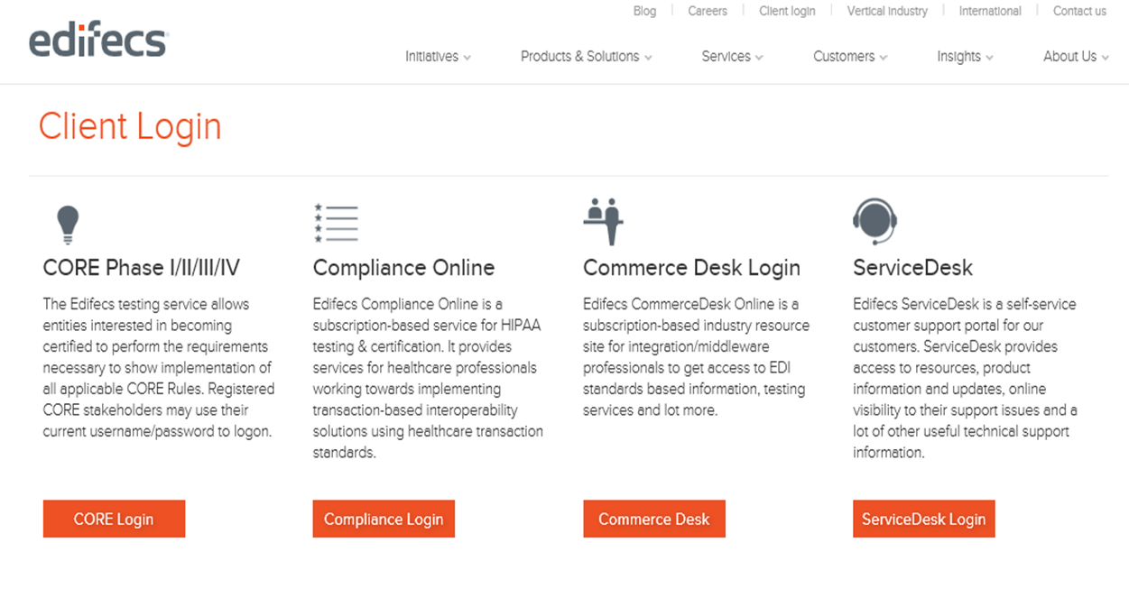
Test
Start here. http://www.edifecs.com/login
Start by selecting the Client Login button under the CORE Phase I/II/III/IV:
Free testing service based on CORE approved test suites.
Dedicated web portal available 24/7.
Online and live support for quick issue resolution.
Notes:
Edifecs has helped over 190 organizations obtain CORE certification. Edifecs can expedite the certification process and maintain on-going compliance with our industry leading services

Slide 34
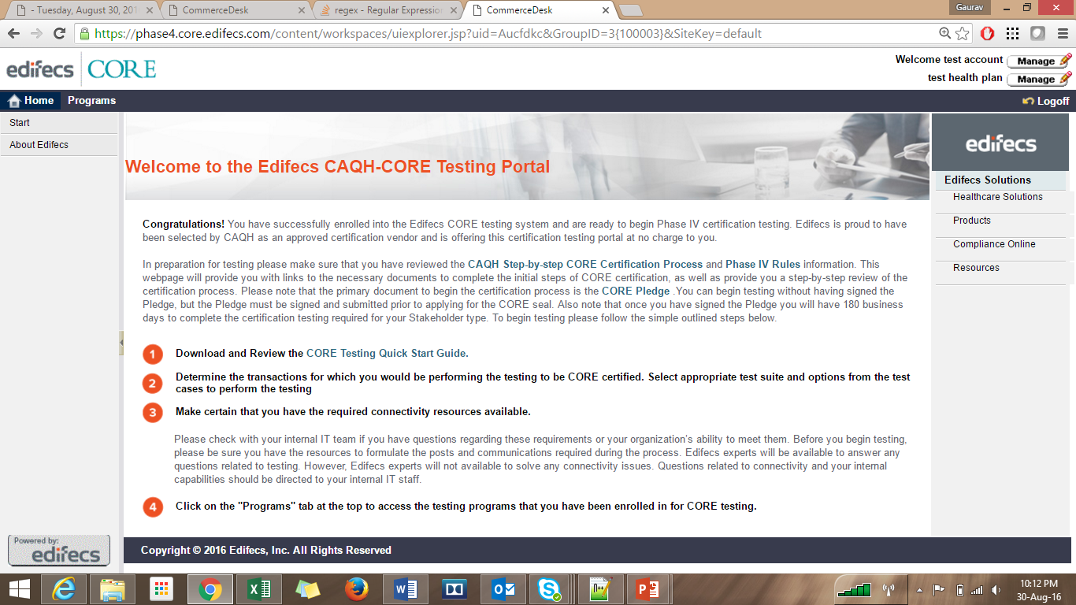
Test
Notes:
Edifecs has helped over 190 organizations obtain CORE certification. Edifecs can expedite the certification process and maintain on-going compliance with our industry leading services

Slide 35
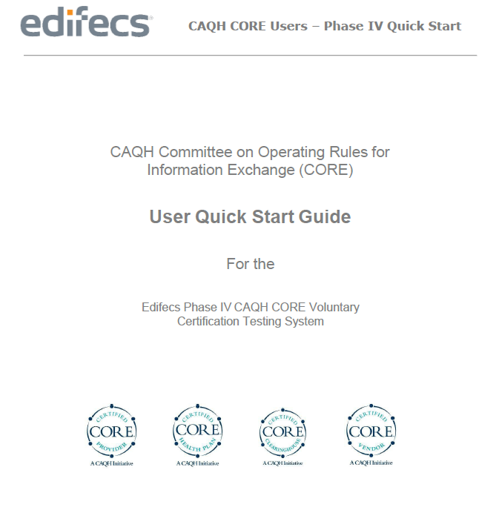
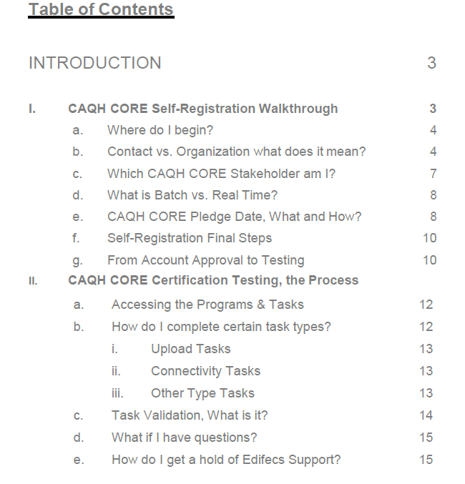
Test
This Guide is to be used in connection with Edifecs CORE Phase IV Certification Testing System. It is meant to serve as an instruction document for the design and general utility of this system and is not a step-by-step CORE Certification guide.
Notes:
Edifecs has helped over 190 organizations obtain CORE certification. Edifecs can expedite the certification process and maintain on-going compliance with our industry leading services

Slide 36
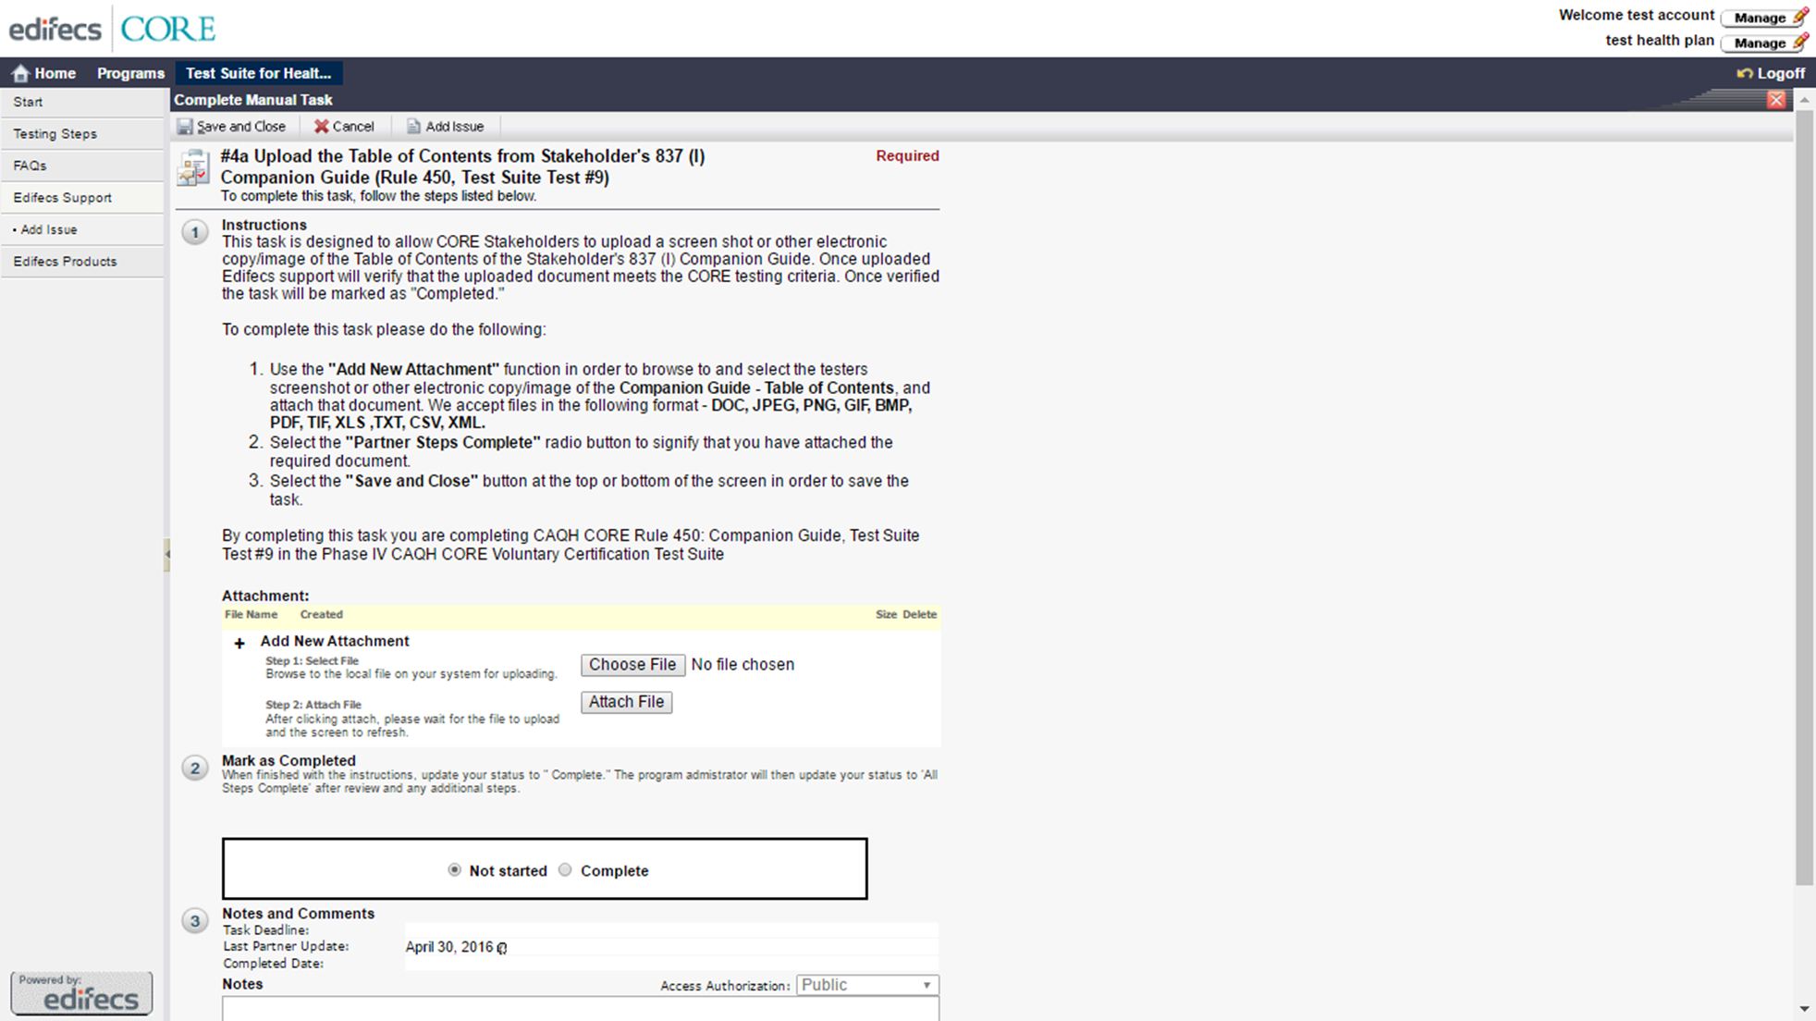
Test & Certify
There is a list of testing tasks corresponding to the program you are testing for.
This task requires the testing entity to provide the required documentation/ supporting artefacts required by the CORE rules.
Notes:
Edifecs has helped over 190 organizations obtain CORE certification. Edifecs can expedite the certification process and maintain on-going compliance with our industry leading services

Slide 37
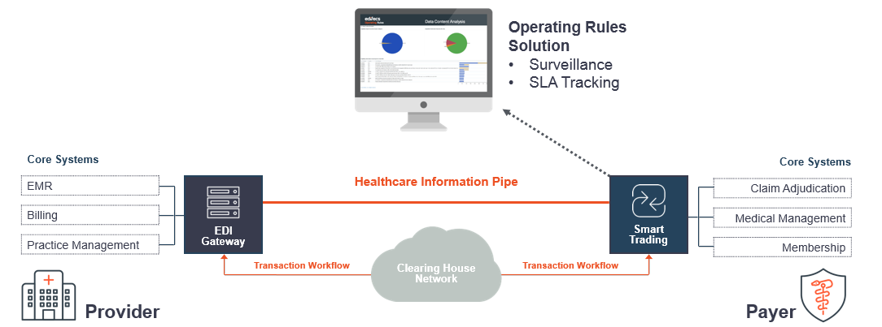
Monitor
Notes:
Edifecs has helped over 190 organizations obtain CORE certification. Edifecs can expedite the certification process and maintain on-going compliance with our industry leading services

Slide 38
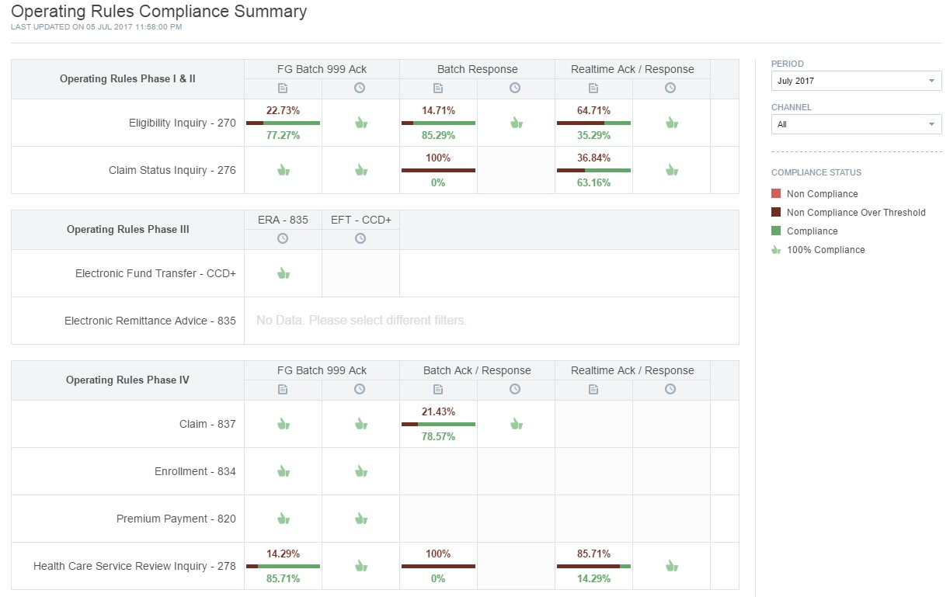
Monitor
Ongoing surveillance to track Operating Rule compliance.
Track responses/acknowledgements and their timeliness.
Track eligibility data content errors and AAA errors.
Track ERA and EFT re-association, and CARC/RARC errors.
Report the errors and statistics in dashboards.
Notes:
Edifecs has helped over 190 organizations obtain CORE certification. Edifecs can expedite the certification process and maintain on-going compliance with our industry leading services

Slide 39
Assess
CORE readiness assessment should include analyzing end-to-end data flow, data content, processing, and compliance for CORE Phase I, II, III and IV rules.
Perform fit-gap analysis for impact business function areas.
Perform systems analysis and planning for implementation.
Prepare a high level roadmap capturing the operational technical strategy that aligns with organizational objectives.
Notes:
Edifecs has helped over 190 organizations obtain CORE certification. Edifecs can expedite the certification process and maintain on-going compliance with our industry leading services

Slide 40
Remediate
Conduct validations of partner transactions.
Perform HIPAA and CORE validations of transactions.
Follow CORE-compliant connectivity protocols and authentication.
Streamline claim responses and status/inquiries.
Notes:
Edifecs has helped over 190 organizations obtain CORE certification. Edifecs can expedite the certification process and maintain on-going compliance with our industry leading services

Slide 41
Taha Anjarwalla
CAQH CORE Manager
Ashish Gandhi
Senior Technical Project Manger
Sergiu Rata
Senior Director of Product Management
Cristina Puscas
Senior Product Analyst, Smart Trading
Moderator: Jessica Porras
Senior Manager
Dialog on Certification Challenges & Resources

Slide 42
Top 5 Challenges
Technical | Stakeholder Identification | Application Process | Trading Partner Alignment | Resource Allocation
Internal Systems Setting Up Connectivity | Getting the right person(s) involved. | Understanding rules or policies. Limited time to implement and test. Maintaining and monitoring compliance. | Transparency and ease of data exchange. | Staff, budget, prioritization, leadership, and time. Creating master test data. Mitigating resource constraints for testing.
The process can be confusing and roadblocks with systems are common. Having helped many organizations get CORE-certified and as a trusted CAQH CORE partner, we fully understand the concerns and challenges of testing.

Slide 43
Edifecs Testing Tips
Ensure that you have gone through the CAQH CORE operating rules of the respective phases as listed on the CAQH CORE site (https://www.caqh.org/core/caqh-core-phase-iv-operating-rules) and that your system have adapted to implement those rules.
Before starting with a testing task, read the testing instructions provided for the task carefully. Perform the task according to the instructions and the corresponding operating rule.
For the connectivity related task it is recommended that, before coming to the portal, you should try to hit your web service through a third party tool (example, SoupUI for testing through soap) as a first step. If you are successfully able to do so and are getting the required results, test the same on the portal.
While performing your task you must take care that the test file you are using does not have data errors, as this would result in failure of the test case.

Slide 44
Polling Question #4
What are the biggest obstacles to pursuing CORE Certification? (Select all that apply.)
Resource allocation.
Leadership/executive buy-in.
Vendor/contractor not certified.
Understanding the requirements.
Other: Please specify in Questions panel.

Slide 45
Audience Q&A
Please submit your questions
Enter your question into the “Questions” pane in the lower right hand corner of your screen.
You can also submit questions at any time to CORE@caqh.org
Download a copy of today’s presentation slides at caqh.org/core/events
Navigate to the Resources section for today’s event to find a PDF version of today’s presentation slides
Also, a copy of the slides and the webinar recording will be emailed to all attendees and registrants in the next 1-2 business days

Slide 46
Upcoming CAQH CORE Education Sessions
2016 CAQH Index: Tracking Industry Trends and Cost Savings in Use of Electronic Healthcare Business Transaction
Wednesday, July 19th, 2017 – 2 pm ET
CAQH CORE Participant Call on Approach to Adoption of Electronic Prior Authorization Transactions
Thursday, July 27th, 2017 – 2 pm ET
This call is only open to CAQH CORE Participating Organizations
Save Time and Money! CAQH CORE and OrboGraph Discuss Value of Implementing the Phase III CAQH CORE Operating Rules
Thursday, August 31st, 2017 – 2 pm ET
To register for these, and all CORE events, please go to www.caqh.org/core/events

Slide 47
Thank you for joining us!
@CAQH
Website: www.CAQH.org/CORE
Email: CORE@CAQH.org
The CAQH CORE Mission
Drive the creation and adoption of healthcare operating rules that support standards, accelerate interoperability, and align administrative and clinical activities among providers, payers and consumers.

